Slide 1
Mobx in React
Sonal Karle

Slide 2
What is Mobx?
Like other similar libraries e.g., Redux MobX is a state manager, but with simplicity and scalability when it comes to state management.
Mobx distinguishes between the following concepts in an application.
State
Actions
Derivations

Slide 3
State:
The State is the data that manages your applications.
It contains different data types ranging from arrays, strings, numbers, and objects that MobX allows you to work with
All you have to do is make sure that all properties you want to change over time are observable so MobX can track them
The TimeView React component wrapped around the observer will automatically detect that rendering depends on the timer.secondsPassed observable, even though this relationship is not defined explicitly.
Every event (onClick/setInterval) invokes an action (myTimer.increase/myTimer.reset) that updates observable state (myTimer.secondsPassed). Changes in the observable state are propagated precisely to all computations and effects (TimeView) that depend on the changes made.

Slide 4
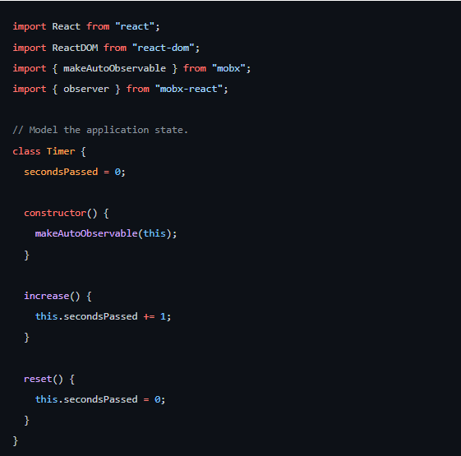
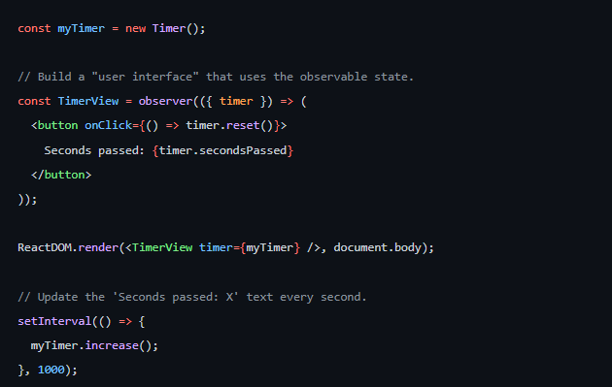

Slide 5
Action:
If a state is your data, then an Action is any block of code that can change such data: User events, Backend data, etc
In the Timer code above, we can see increase and reset methods that change the value of secondsPassed.
Methods that modify the state are called actions in MobX
Derivation:
Whatever that is gotten from the state is known as derivation, and it exists in different forms, but we’ll be looking at the different kinds of derivations of MobX:
Computed Values
Reactions

Slide 6
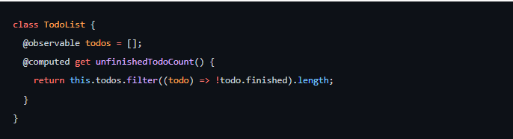
Computed Values:
These are values that can be derived from the state using a pure function.
They will be updated automatically by MobX, and they are suspended when not in use.
Below is an example of a Computed Value.

Slide 7
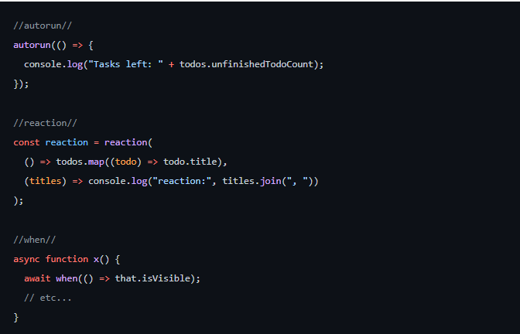
Reactions
Reactions are like computed values: they react to state changes but instead produce side effects.
In React, you can turn stateless function components into reactive components by simply adding the observer function.
Observer converts React function components into a derivation of data they render.
MobX makes sure the components are always re-rendered when needed but not more than that
Custom Reactions can be created using autorun, reaction, or when.

Slide 8
Why should you consider MobX?
The main goal of MobX is to improve state management for developers and create an easier way of managing Javascript application states with less code and boilerplates.
MobX uses observable data, which helps track changes automatically, making life easier for developers.
MobX allows you to manage your application state outside of any framework.
This makes code decoupled, portable, and easily testable

Slide 9
MobX vs. Redux
Unlike other state managers like Redux , MobX uses multiple stores to handle the application state.
You can separate the stores so all application states will be in a single store like Redux.
One of the top issues about Redux is the amount of boilerplate code that comes with it, and integration with React leads to excess boilerplates, which developers find unappealing.
MobX requires little or no boilerplate code and does not require any special tools, making its setup simple and easy.

Slide 10
While creating mobx-Application we need run some basic command
npx create-react-app todo-app --template typescript
Then we change our directory and install the needed dependencies before creating our components and state.
cd todo-app
npm install -s mobx mobx-react-lite
npm start

Slide 11
THANK YOU

